Slide 1
C
haracteristics of
innovation
Dr. Theresa Murphrey
Texas A&M University

Slide 2
Outline
What is an innovation?
What is meant by the change process or adoption of an innovation?
Characteristics of an innovation

Slide 3
Definition
Innovation: “an idea, practice, or object that is perceived as new by an individual or other unit of adoption” (Rogers, 2003, p. 12)
Perception is important!

Slide 4
“Change Process” and “Adoption of Innovation”
Change = moving from one state to another
Aspects can make process complicated
Values
Philosophies
Ways of looking at things
Differences can help or hinder
Adoption is not an easy process
May decide change is not needed
Understanding → effective

Slide 5
Rogers’ 5 Characteristics
https://www.fullestop.com/blog/characteristics-innovation/
Relative advantage
Compatibility
Complexity
Trialability
Observability
1
2
Provides a framework
3
4
5

Slide 6
#1: Relative Advantage
How the innovation compares to what already exists
How much relative advantage does this item have?
Is there economic profit, a lighter workload, a savings in time?
What is the advantage of switching to this item or process?

Slide 7
#2: Compatibility
How harmonious the new item or process is with the current situation or individual
Values
Past experiences
Physical and mental aspects
Culture plays a big part

Slide 8
#3: Complexity
How difficult is it to use?
Often associated with “usability”
Can vary greatly across individuals – connected to many attributes
Age
Education
Culture
Exposure

Slide 9
#4: Trialability (divisibility)
Sometimes difficult to determine – not everything can be tried out in small ways
Example: renting or leasing vs. buying
Can you adopt it partially, or must it be all at once?

Slide 10
#5: Observability
Weed killers vs. post-emergent weed killer
If it’s not observable – it may be difficult to get people to adopt it.
AKA “reaction”: what is observed by others and will impact others’ opinions

Slide 11
Rogers’ 5 Characteristics
Relative advantage
Compatibility
Complexity
Trialability
Observability
1
2
Being able to describe an innovation with these can encourage or discourage adoption
3
4
5

Slide 12
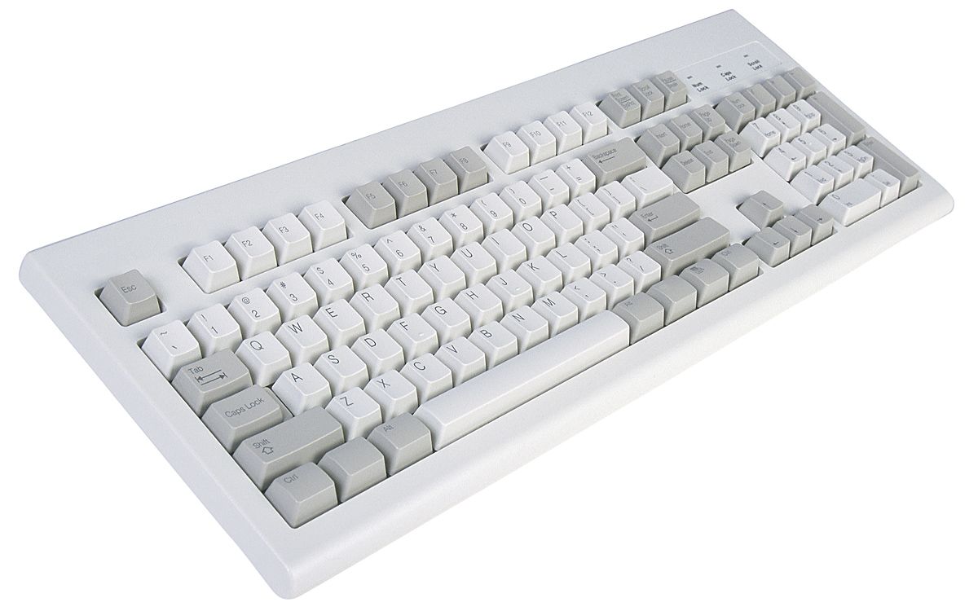
The Keyboard Not Adopted: QWERTY Keyboard vs. Dvorak Keyboard
The QUERTY Keyboard is the traditional keyboard – designed to slow down typing..
The Dvorak Keyboard reconfigured the letters to be in more efficient locations.

Slide 13
Unsuccessful: Dvorak Keyboard
Characteristic | Dvorak Keyboard
Relative advantage | Low - required retraining
Compatibility | Low - required additional purchase
Complexity | High – required retraining
Trialability | Low – not in computer lab
Observability | Low – not in computer lab

Slide 14
Successful: Cell Phone
Characteristic | Cell Phone
Relative advantage | Yes – saves time, portable, status symbol
Compatibility | Yes – critical mass adoption not necessary
Complexity | Not complex – same skills used
Trialability | Yes – easy to borrow
Observability | Yes – used in public places

Slide 15
Conclusions
Rogers’ Five Characteristics of an Innovation
Perception will vary
Understanding → able to develop strategy to encourage or discourage adoption

Slide 16
“Awareness of a problem does not automatically translate into a desire for change.”
Find connecting link
Bring in outside viewpoint
Show them possibilities to solve problem
Be very good at listening

Slide 17
Have a great day!
C
haracteristics of
innovation

